Slide 1
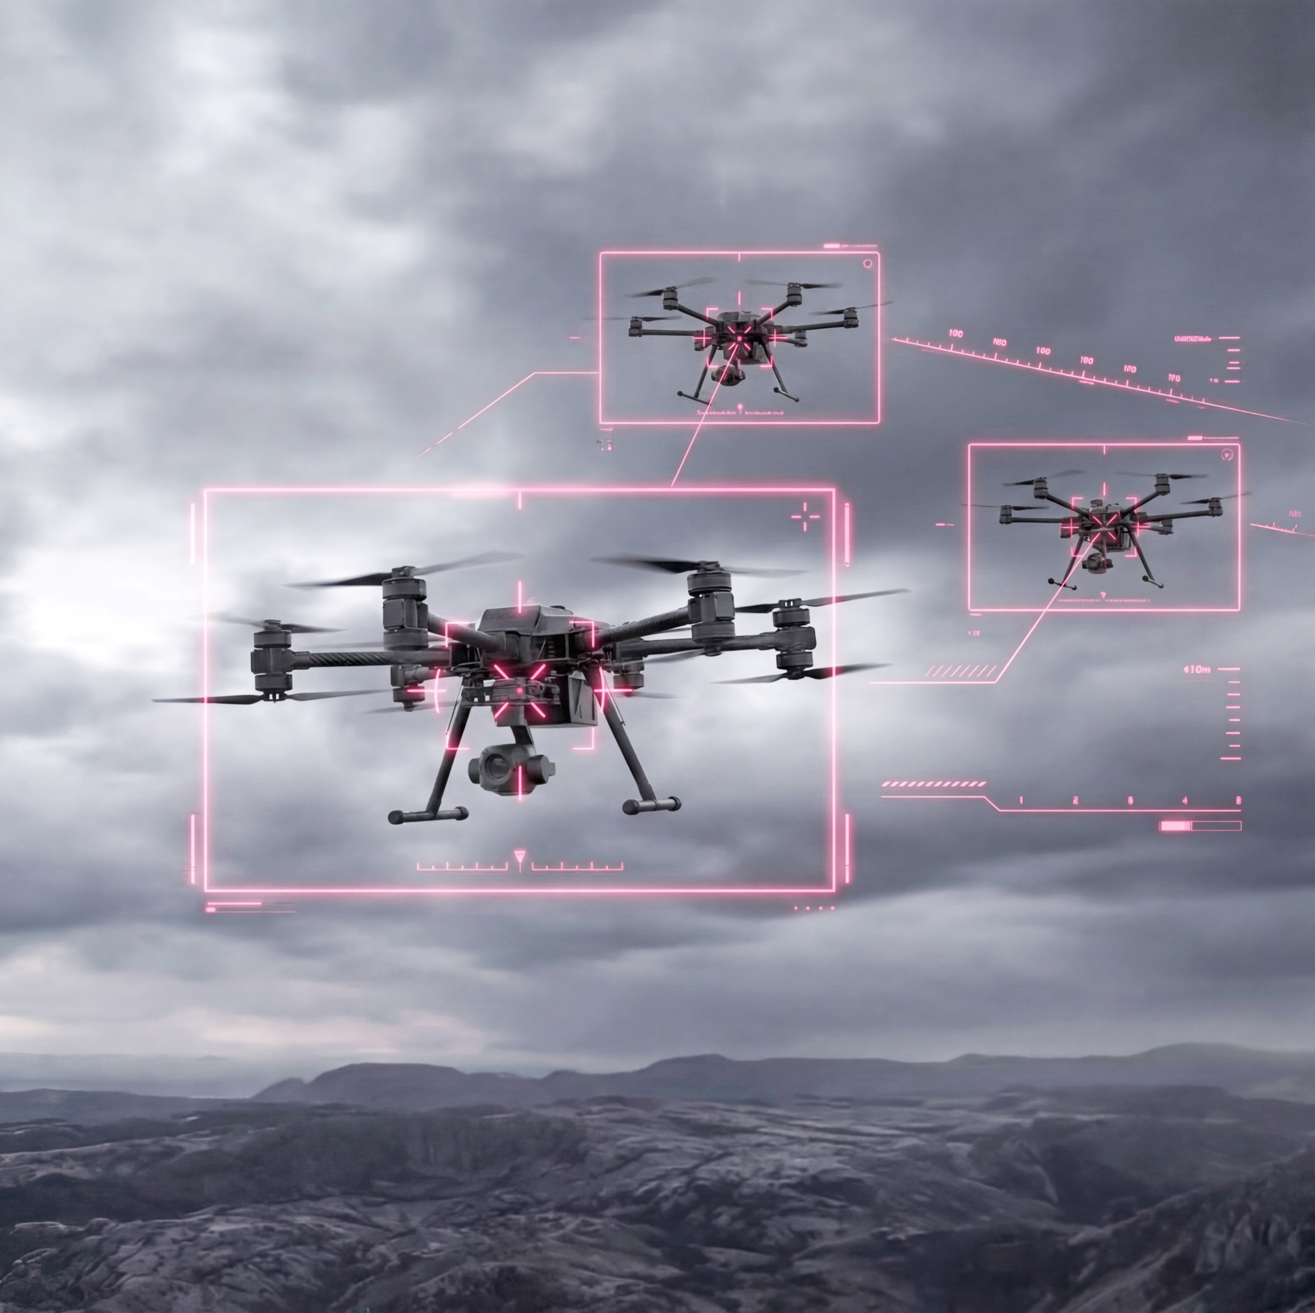
Integrated drone protection systems

Slide 2
About the company
Yukaplanet specializes in supplying modern drone protection systems for industrial sites, including petrochemical enterprises, energy, warehouses, and infrastructure.
Yukaplanet offers turnkey solutions: from site surveys and design to supply, installation, and maintenance.
Our competitive advantages:
Fast delivery and production. Factory stocks allow dispatch in 1–14 days, without import delays.​
Individual approach. Projects based on object geometry, calculating loads and testing, adapting to object geometry.
Reliability and localization. Resistance to damage, wind, and snow, with emergency repair options; integrates with existing security systems.
Complexity. From surveys to maintenance, with documentation and threat audits — 30–50% cheaper than imported analogs.​
Compliance with standards. Certified by the Ministry of Construction of the Russian Federation, suitable for restricted and civilian facilities.​
We will provide customer references upon request. Yukaplanet – an authorized supplier with the highest partner status.

Slide 3
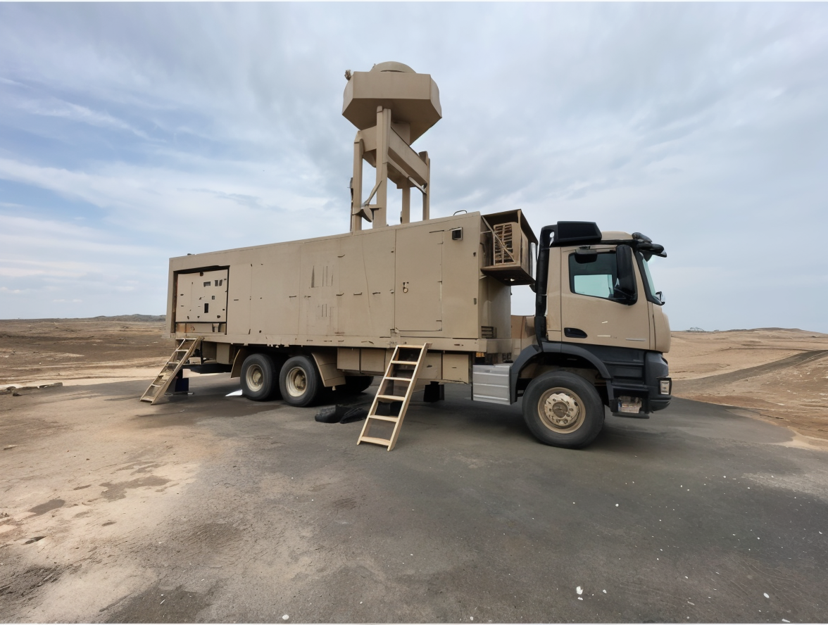
CETC Sky Shield: Integrated drone defense system

Slide 4
Sky Shield
Sky Shield (Tian Dun) is an integrated drone defense system developed by China Electronics Technology Group Corporation (CETC). Designed as a modular, multi-layered solution, Sky Shield combines advanced radar detection, electro-optical tracking, electronic warfare countermeasures, and kinetic kill capabilities using high-energy lasers to neutralize the growing threat of low-altitude air incursions.

Slide 5
The Sky Shield system employs a multi-layered 'soft/hard kill' approach to neutralize threats at various ranges.

Slide 6
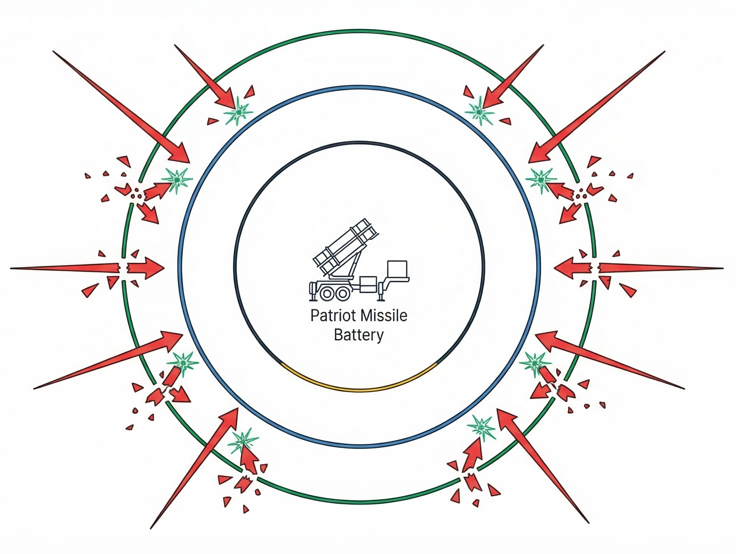
Proven in real combat conditions: 100% interception effectiveness
After Action Report
Combat Deployment
Location: Jeddah, Saudi Arabia (2022);
Protected object: Patriot missile system battery;
Threat: drone kamikaze;
Result: 21 intercepted / 21 detected (100% effectiveness).
Testing and Evaluation Phase
DETECTION
Testing Period: 1 year;
Threat Profile: Reconnaissance drones, loitering munitions;
Result: 110 intercepted / 110 detected (100% effectiveness).
TACTICAL AMBER
SOFT KILL/EW
HARD KILL/INTERCEPT
PRECISION GREEN

Slide 7
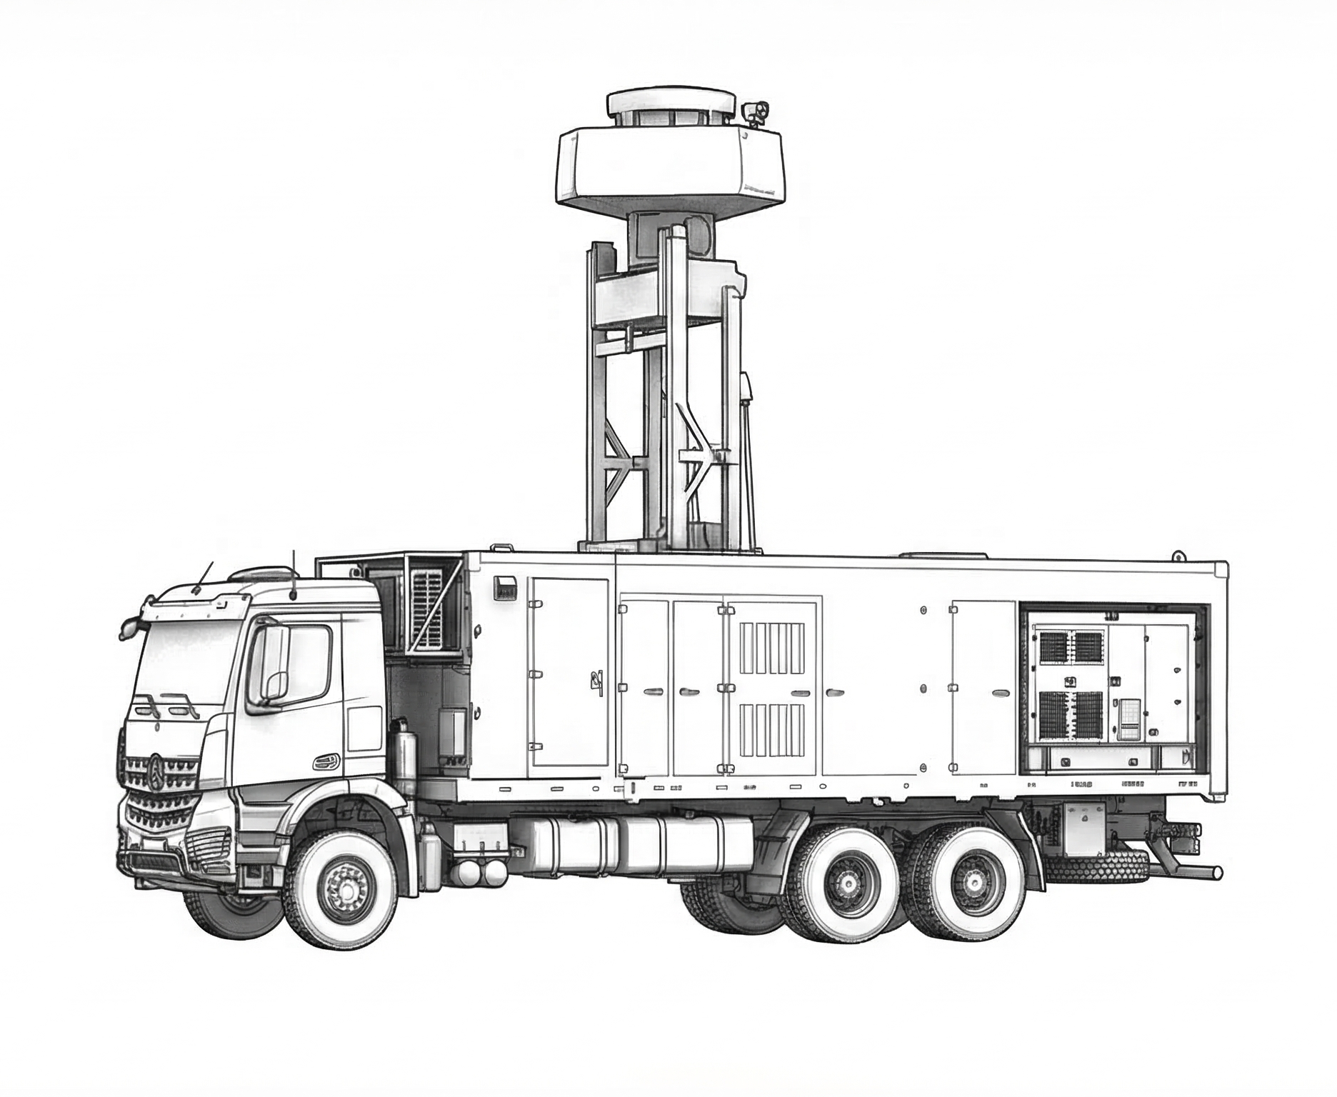
Anatomy of the complex: Mobile platform Sky Shield (Tian Dun)
Modular architecture combining kinetic and non-kinetic means of defeat on a single chassis
Active detection module 3D TWA / AESA (AESA) radars and distributed optoelectronic/IR sensors for targeting.
EW module (Soft-Kill) Integration of JN1101 electronic countermeasure systems.
Directed energy system (Hard-Kill) Installation of high-energy laser Silent Hunter and power generation systems.

Slide 8
Layered architecture: Combat management cycle (Kill Chain)
Seamless transition from long-range detection to physical destruction
1. Detection and tracking
3D TWA and AESA radar;
Optoelectronic identification.
2. Radioelectronic suppression
Soft-Kill: JN1101 jammers;
Interruption of communication and navigation channels.
3. Physical destruction
Hard-Kill: Silent Hunter laser;
Structural destruction of the target.
Distant line
Medium line
Close line

Slide 9
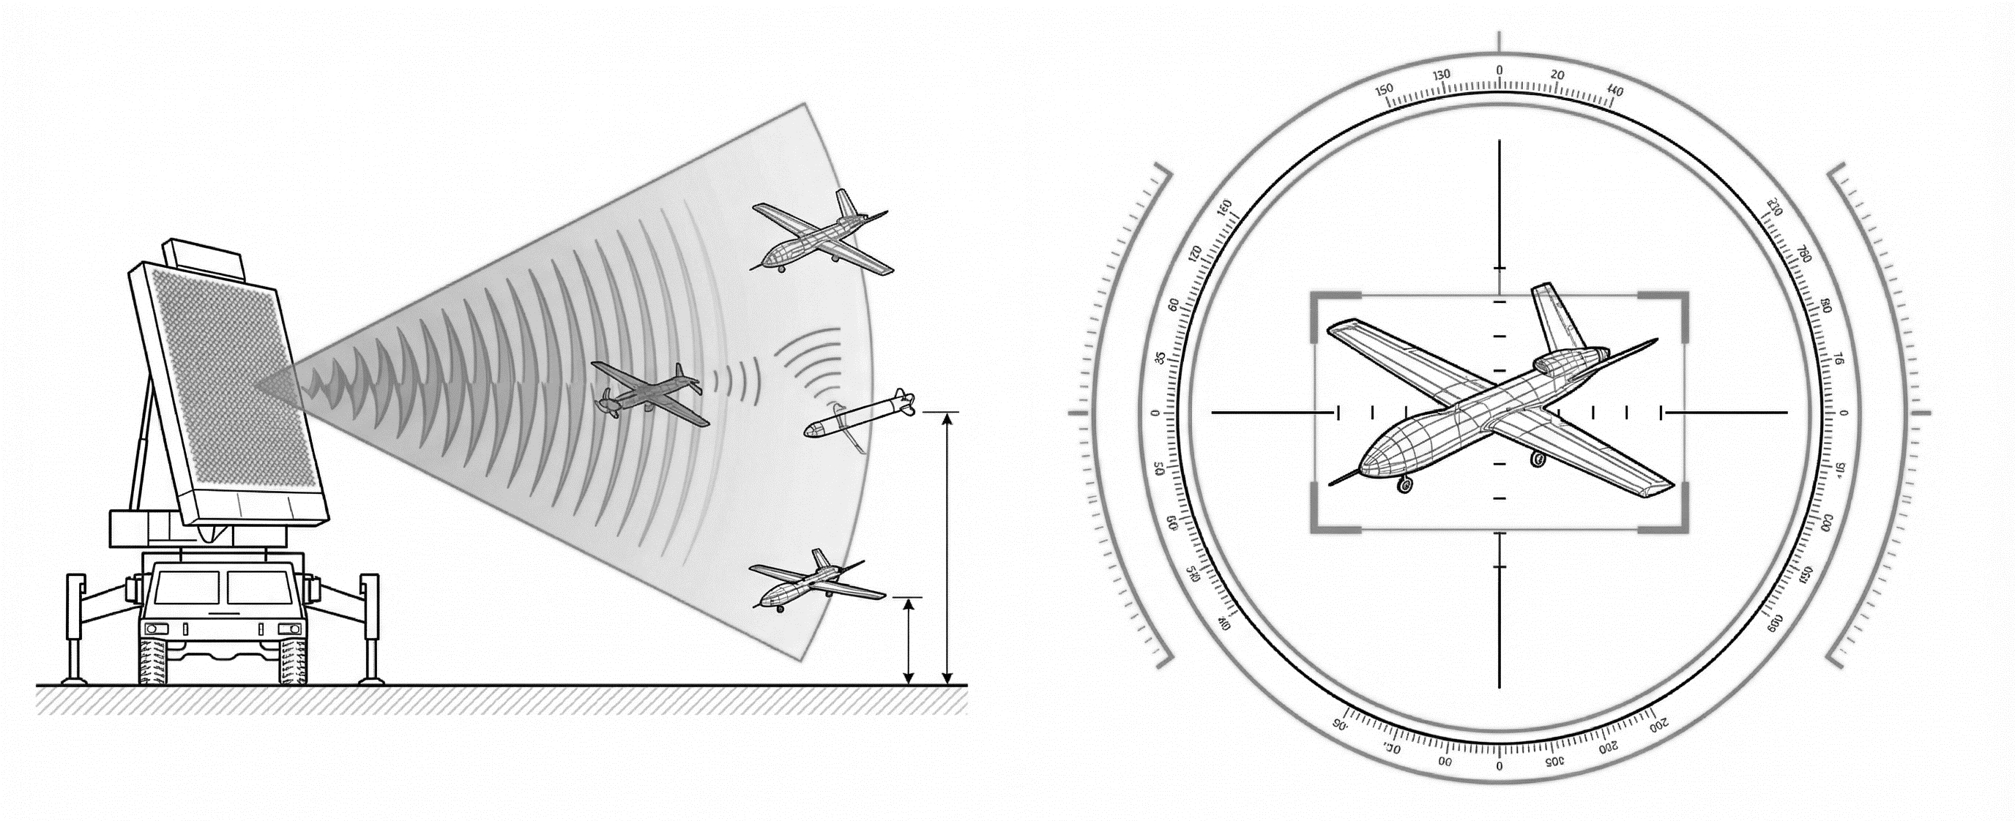
Echelon 1: Active detection and targeting.
Early warning and precision tracking of low-flying targets.
Radar complex.
Technology: 3D TWA and radars with active phased array antenna (APAA);
Function: Long-range surveillance and capture of low-altitude targets (UAVs, loitering munitions).
Optoelectronic systems.
Technology: Distributed optical and infrared sensors;
Function: Accurate identification and tracking of the target.

Slide 10
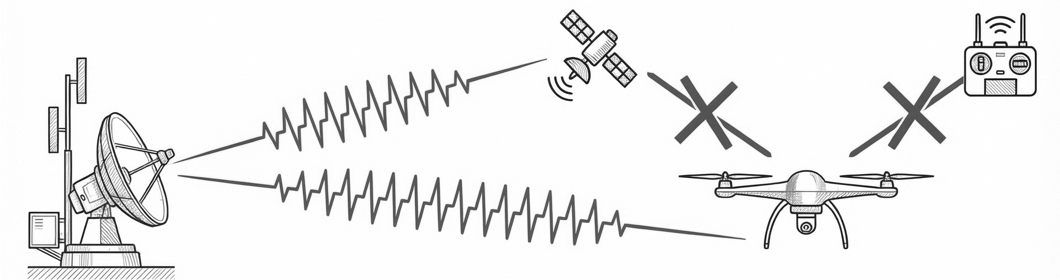
Electronic warfare (Soft-Kill).
Neutralization of the threat without kinetic impact through jamming.
UAV countermeasure system JN1101.
Specialized electronic warfare complex integrated into the architecture of Sky Shield.
Attack vector 1:
Communication channels — blocking telemetry and control commands.
Attack vector 2:
Navigation — suppression of signals from global navigation satellite systems (GNSS), forcing UAVs to make emergency landings or veer off course.

Slide 11
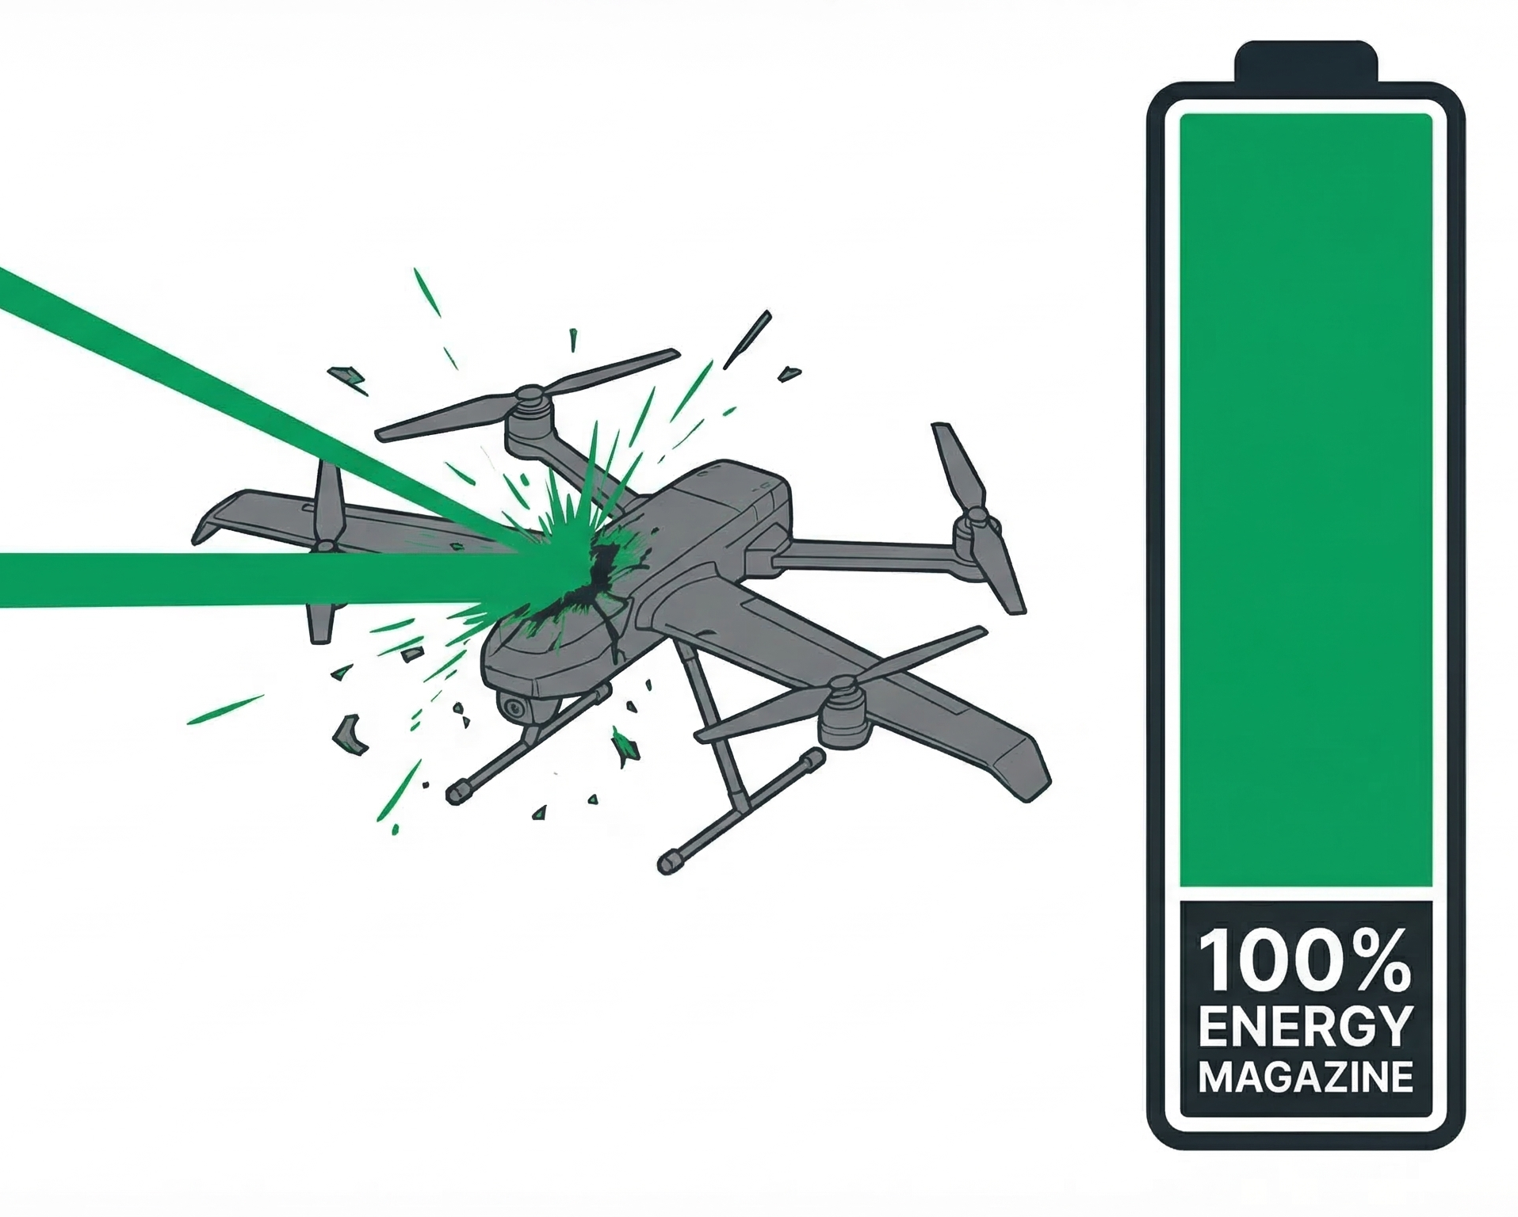
Echelon 3: Directed energy weapon Silent Hunter (Hard-Kill)
High-energy laser for guaranteed physical destruction
Directed energy weapon. Direct physical destruction (hard-kill) of aerial targets at short ranges.
Unlimited ammunition supply. Absence of traditional munitions: as long as there is a power source, the system is ready to fire.
Zero time of approach. Target defeat at the speed of light, which is critically important for countering highly maneuverable targets in the final segment of the trajectory.
Resistance to swarm attacks. The ability to quickly shift fire from one target to another without the need for reloading.

Slide 12
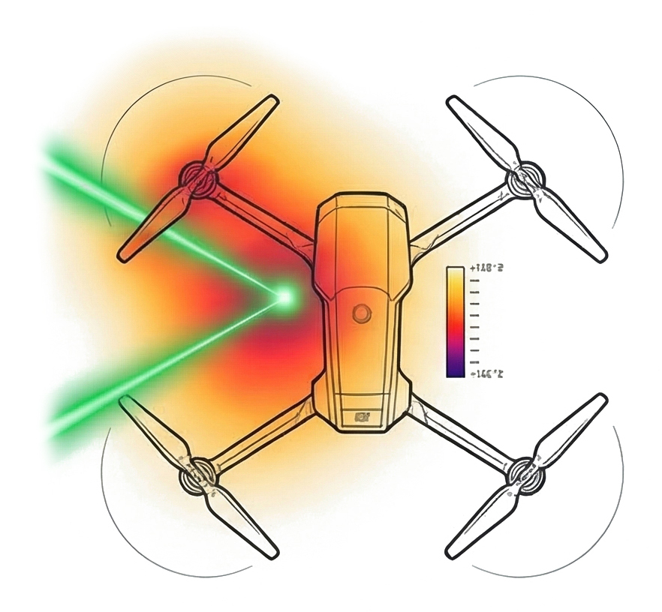
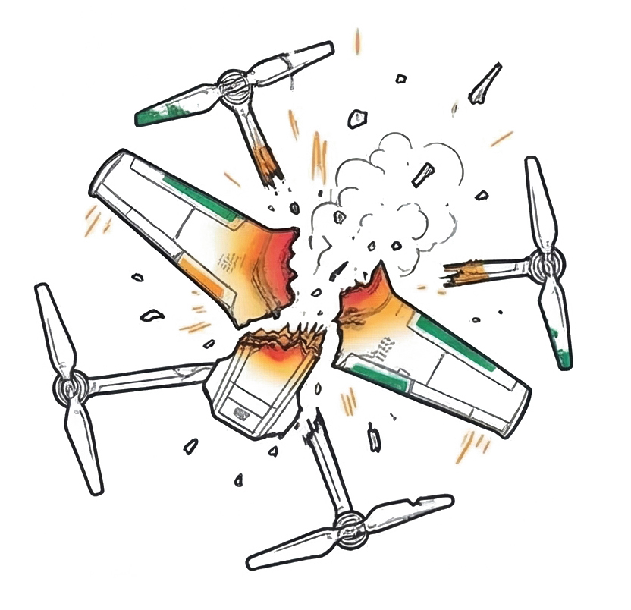
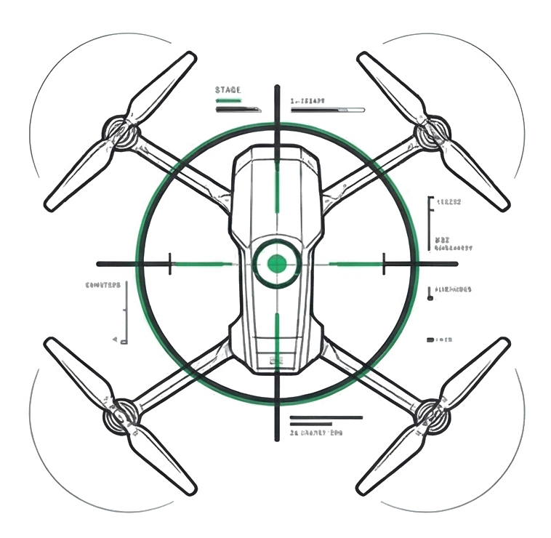
Dynamics of defeat: The burn-through process.
Mechanics of catastrophic structural failure of UAVs in flight.
STAGE 1:
STAGE 2:
STAGE 3:
Optoelectronic capture.
The system continuously keeps the laser beam focused on the vulnerable point of the maneuvering target.
Concentration of thermal energy.
The high-energy beam affects the composite or metallic elements of the structure (wing, rotor) causing critical overheating.
Catastrophic destruction.
Aerodynamic loads combined with structural unfolding lead to the immediate destruction of the drone in the air.

Slide 13
Economics of Air Defense: Asymmetry of Costs
Why traditional interceptors are economically unviable against cheap threats
 | Традиционные ЗРК (Patriot) | Направленная энергия (SKY Shield)
Стоимость выстрела (Cost per Kill) | Миллионы долларов за ракету. Катастрофически невыгодно против дронов стоимостью $20,000. | Стремится к нулю. Затраты равны стоимости дизельного топлива/электричества для генератора.
Глубина боекомплекта (Magazine Depth) | Ограничена пусковыми установками (требует физической перезарядки, риск истощения при роевой атаке). | Виртуально неограничена. Ограничивается только запасом топлива для энергоустановки.
Тактическая устойчивость (Tactical Sustainability) | Высокий риск перенасыщения (Saturation attack). | Идеально подходит для отражения массированных атак благодаря быстрому переносу огня.

Slide 14

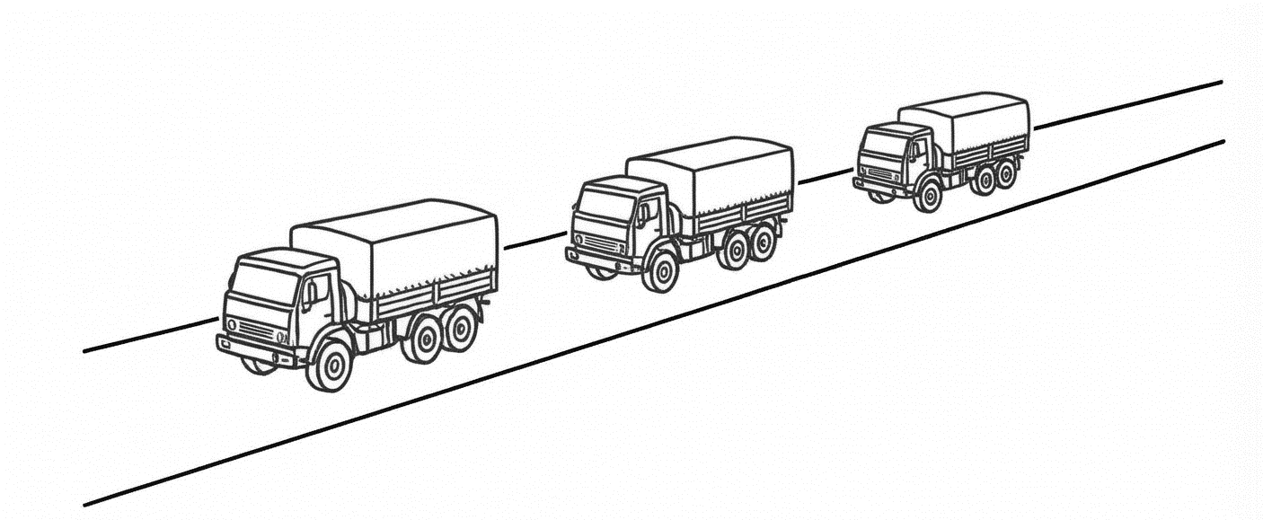
Flexibility of Application: Modular Deployment Profiles
Adaptation to Specific Customer Tasks and Operational Scenarios
Protection of Critical Infrastructure (Stationary Deployment)
Protection of airfields, power plants, and oil refining complexes.
Constant standby powered by stationary electric grids for continuous protection.
Covering military groups (Mobile deployment)
Integration on high-mobility automotive chassis.
Escort of convoys, protection of field headquarters and S-300 positions (as in the case of protecting Patriot batteries).

Slide 15
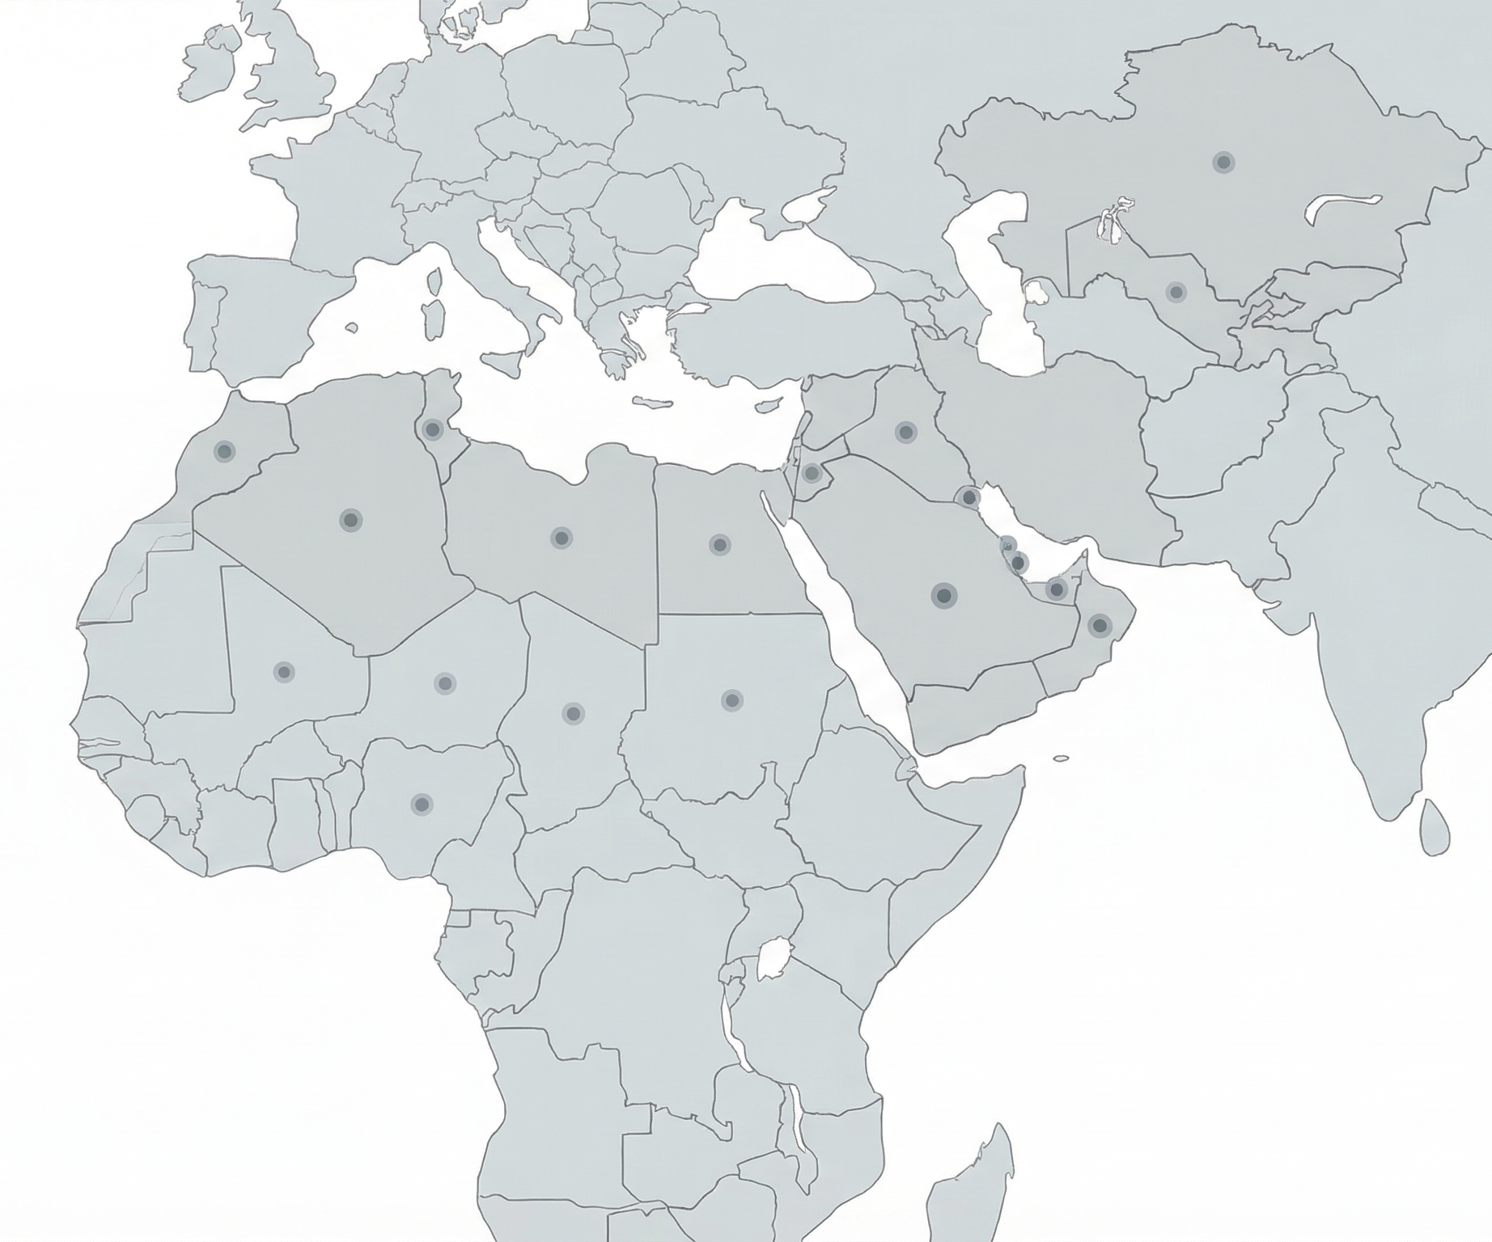
Global presence and export potential
A sovereign solution successfully competing in the international arms market
Export scale: The system is in service in approximately 20 countries in the Middle East, Central Asia, and Africa.
Saudi Arabia
Key partners: Saudi Arabia (proven combat use) and Oman (recent data on logistical deployment).
Market competition: CETC Sky Shield directly competes for contracts with Western defense giants such as Thales and Rheinmetall.
Oman
Status: A full-fledged sovereign solution for military and civilian tasks in airspace protection.

Slide 16
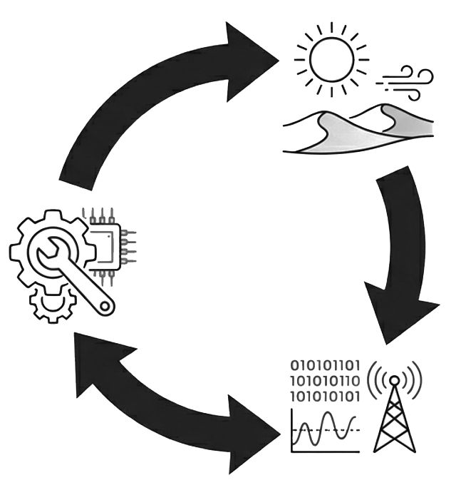
Evolution Based on Combat Experience: Adaptation Cycle
A Sovereign Solution, Successfully Competing in the International Arms Market
Field Data Experience in Desert Regions of the Middle East Revealed Critical Factors: The Impact of Fine Dust on Optics and Extreme Thermal Loads on Laser Systems.
CETC Modernization Implementation of Hardware Improvements: Enhanced Thermal Protection, Upgraded Cooling Systems, and Protection of Optical Paths. The Sky Shield System is Constantly Evolving.
Feedback Transmission of Operational Telemetry and Reports from Bases Back to Developers.

Slide 17
Synthesis: Adaptive Asymmetry
Transformation of the Economic Imbalance of Modern Warfare
Change of Paradigm
Sky Shield not only knocks down drones. It reverses the economic asymmetry of modern conflicts. By turning a swarm attack from an exhausting financial threat into an easily managed tactical incident, the system returns the advantage to the defending side.
Development vector: AI integration
Currently, SETS is integrating artificial intelligence modules into future variations of the complex. Goal: Automation of target recognition, minimization of response time, and ensuring fully autonomous operation against complex, evolving threats.

Slide 18
"...the system has been exported to about 20 countries..."
"...continuous improvement based on field data... regarding performance in extreme desert conditions..."

Slide 19
AWP C-UAS 2025: Architecture of the integrated UAV defense system
Software-defined radio (SDR) technologies, stationary and mobile solutions for precision counter-drone measures.

Slide 20
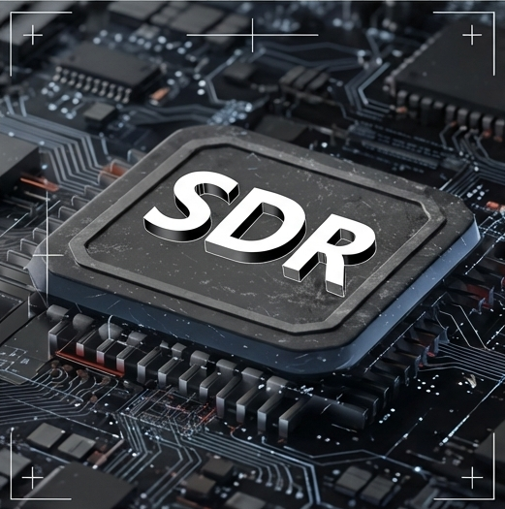
Technological core: SDR (Software Defined Radio) architecture
Foundation of the complex Fundamental technology that provides digital signal processing. Replaces rigid hardware filters with flexible software algorithms.
Adaptability Instant reconfiguration of working frequencies and suppression algorithms in response to evolving threats and the emergence of new UAV communication protocols.
Intelligent processing Ensures high response speed and precise signal separation, which is a critical factor for implementing the concept of precision suppression.

Slide 21
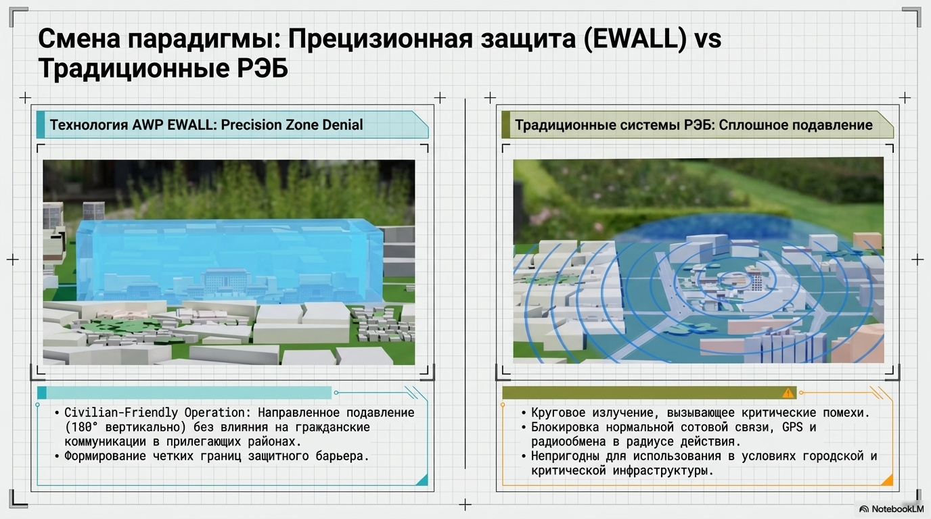
Paradigm Shift: Precision Protection (EWALL) vs Traditional EW Systems
AWP EWALL Technology: Precision Zone Denial
Civilian-Friendly Operation: Directed Suppression (180° Vertically) without Impact on Civilian Communications in Adjacent Areas.
Establishing Clear Boundaries of the Protective Barrier.
Traditional EW Systems: Continuous Suppression
Circular Emission Causing Critical Interference.
Blocking Normal Cellular Communication, GPS, and Radio Exchange Within Range.
Unfit for Use in Urban and Critical Infrastructure Conditions.

Slide 22
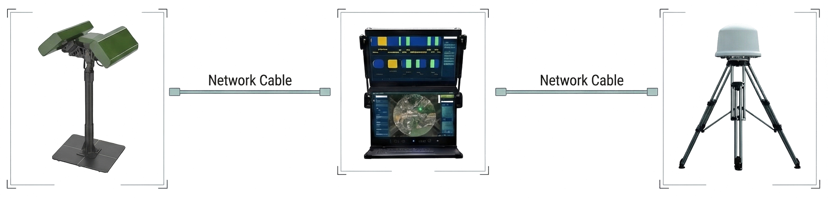
Echelon 1: Fixed Bases C-UAS
Autonomous Early Detection and Precision Suppression Infrastructure
AC 220V
AC 220V
AT-610 EWALL (Effector)
Suppression ranges: 400MHz / 800-900MHz / 1.2GHz / 1.4GHz / 1.5GHz / 2.4GHz / 5.2GHz / 5.8GHz
Response time: < 5s
GPS Positioning: External antenna (BDS / GPS / GLONASS / Galileo)
Protection class: IP66
AT-606 (Detector)
Operating method: Radio frequency detection
Frequency range: 30MHz - 6000MHz
Directivity: 360° omnidirectional
Recognizable patterns: 300+
Target Capacity: ≥ 100

Slide 23
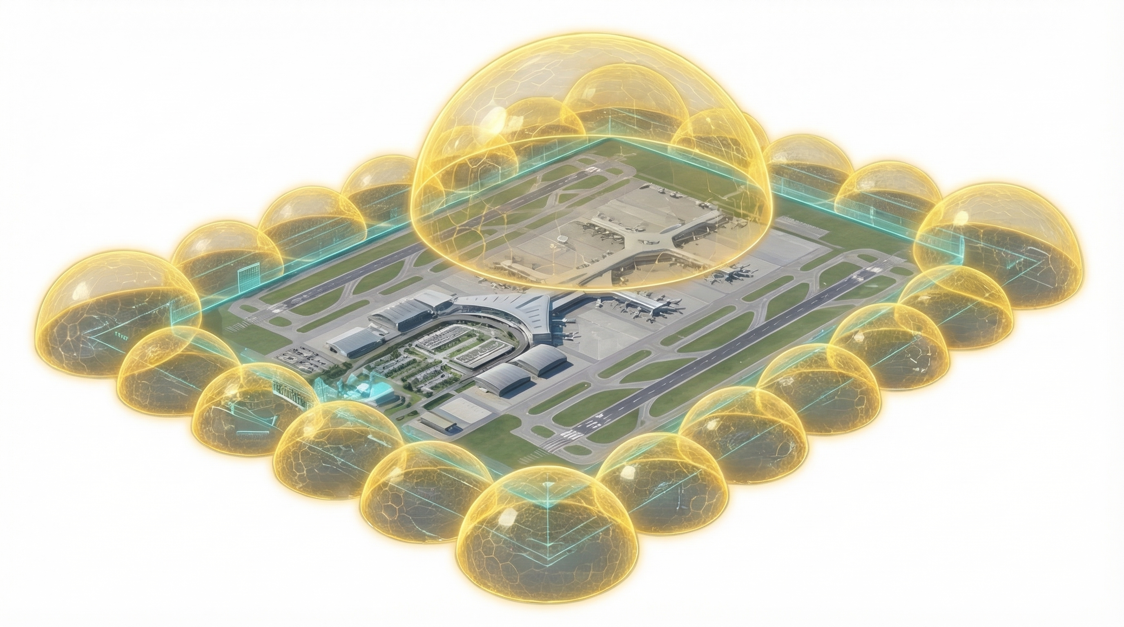
Deployment Profile: Protection of Critical Infrastructure
Edge Network Deployment Flexible Scaling. Forming a closed protective perimeter (domes) from multiple AT-610 modules around any area object.
500m Height
500m Width
50m Thickness
Autonomy and Swarm Protection
Unmanned Operation: Fully autonomous operation 24/7 without operator intervention.
Swarm Defense: Guaranteed protection against swarm attacks from FPV and commercial drones.
Application Vectors Ideal for: VIP residences, brigade command posts, military camps, and energy plants.

Slide 24
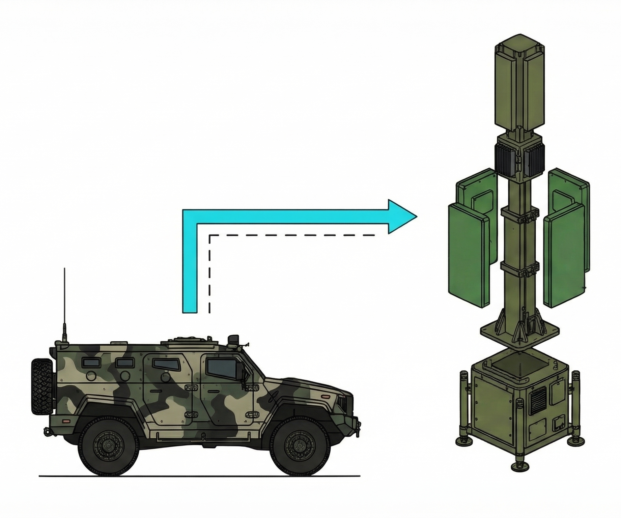
Echelon 2: Tactical mobile solutions (AT-625)
Modular architecture (Military Use) for integration onto armored vehicles
Control Unit: Central coordination module.
Module for countering FPV (Jamming Frequency Counter - FPV Unit) Operating frequencies: 800MHz / 900MHz / 2.4GHz / 5.8GHz
Module for countering commercial UAVs (Commercial UAV Unit) Operating frequencies: 1.2GHz / 1.5GHz / 2.4GHz / 5.2GHz / 5.8GHz

Slide 25
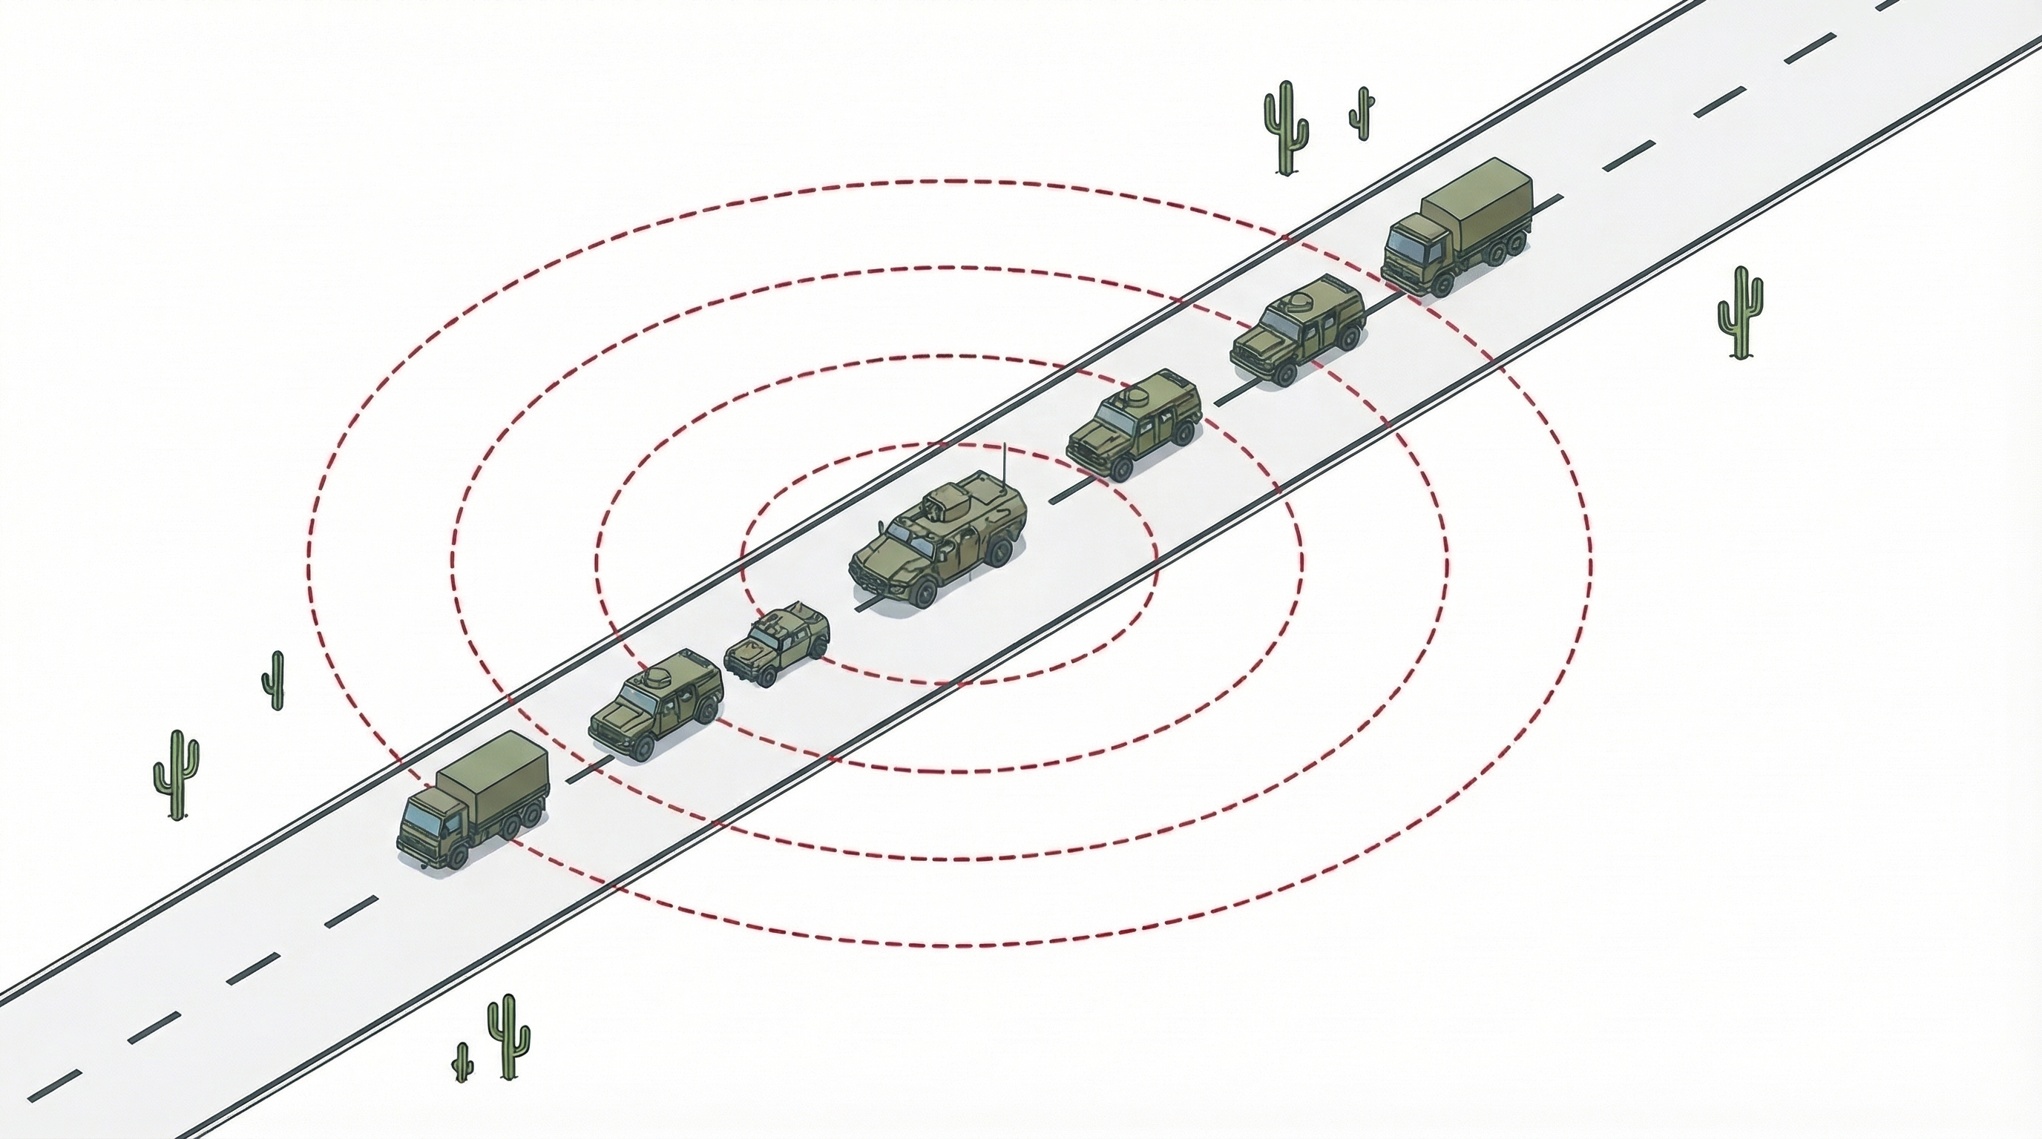
Deployment profile: Mobile cover for troop columns
Defense radius: 1000m (from the lead and trailing vehicle)
Tactical characteristics
Effective jamming distance: ≥ 1 km.
JCR 2:1 for OcuSync 4 protocol.
JCR 1:1 for FPV drones (TBS/ELRS protocols).
Creating a continuous dynamic dome for protection against low-altitude threats on the march.
Spacing: 100m (distance between vehicles)
Distance: 600~700m (between the first and last vehicle in the column)

Slide 26
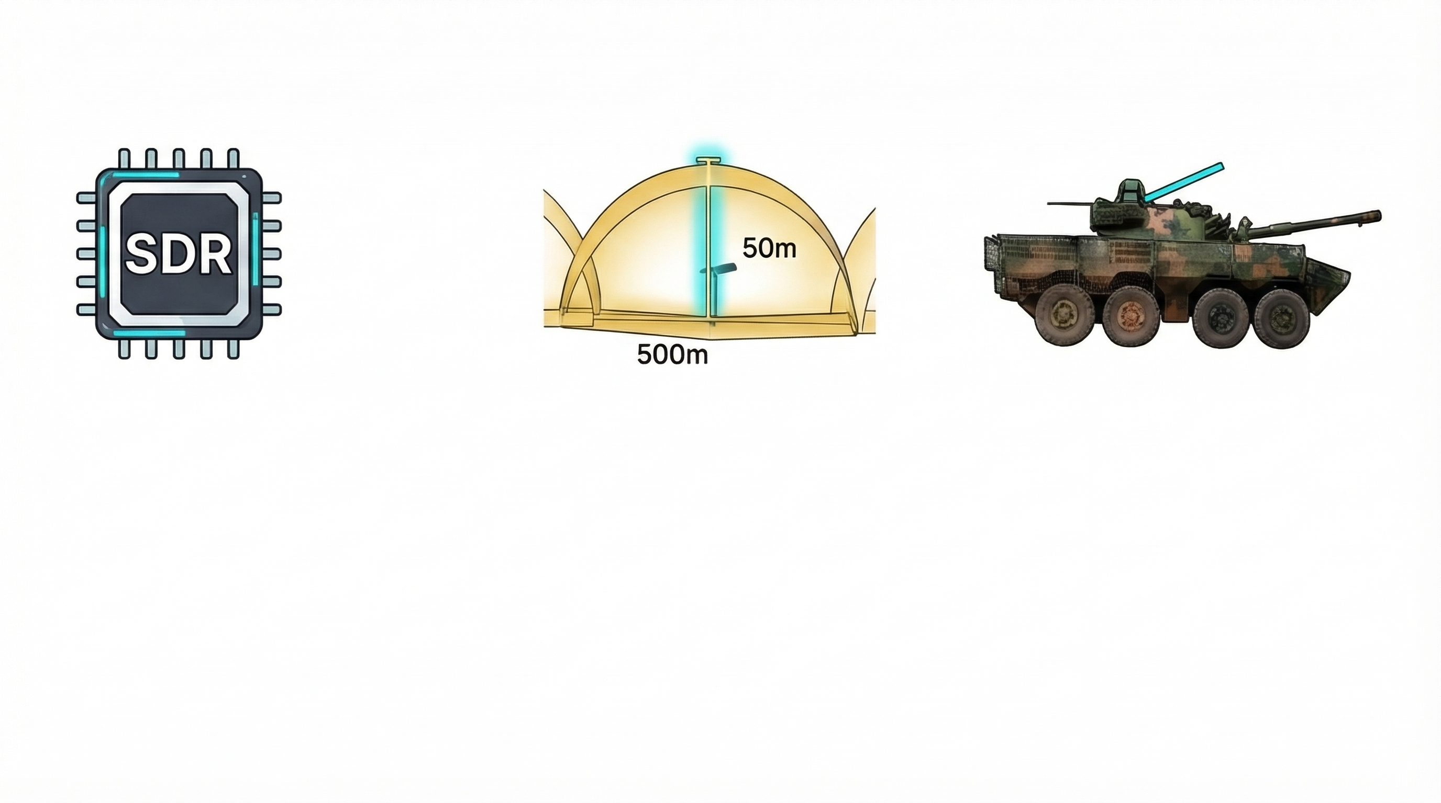
Synthesis: Universal defense architecture AWP1
1. Innovative Core
SDR (Software Defined Radio) technologies
Intelligent processing and adaptability to the evolution of protocols.
2. Stationary Shield
AT-610 EWALL / AT-606 Systems
Precision Zone Denial without side effects for civilian infrastructure.
3. Tactical Mobility
Modular complexes AT-625
Dynamic echeloning and cover for armored groupings on the march.
AWP C-UAS provides a full range of precision protection against modern swarm and FPV threats, returning absolute advantage to the defending side.

Slide 27
Thank you for your attention!

